Slide 1
COVID-19 Anxiety and Psychological stress: Cultivating Positive Coping Strategies
KPA CME
M. Mathai
27.01.22

Slide 2
Objectives
The objective of this presentation is to remind us
That we as mental health providers owe it to ourselves to provide mental health to ourselves
I am throwing-out a challenge to each one of us as we start the YEAR 2022 to ensure we have set aside time for SELFCARE

Slide 3
Introduction
On January 30th, 2020, the WHO finally declared COVID-19 a "Public Health Emergency of International Concern”
We thought it would be a short lived pandemic- now we are counting variants
We have now been living with COVID-19 for nearly 2 years in Kenya for since the first case was reported in March 2020
Today 321,000 5,565 deaths- still counting
We have reason to be grateful that we have survived individually even as we mourn colleagues and relatives and friends that we have lost

Slide 5
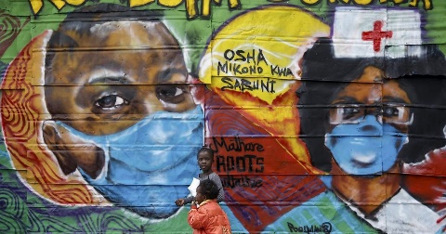
Living the new Norm
We have learned to live the “New Norm”
We wear masks whenever we go out of the house
Some of us work from home
We wash our hands and sanitize all the time
We have been vaccinated and boosted

Slide 6
We don’t shake hands with friends
We don’t hug
We stand apart and away
We no longer feel easy in social places- not like the way we used to
We have experienced lockdowns and curfews
We are trying hard
But the fear is never too far off
Will it ever be the same again?

Slide 7
Stress during a crisis
FEAR
ANXIETY
BURNOUT
DEPRESSION
VICARIOUS TRAUMA/ SECONDARY TRAUMATIC STRESS

Slide 8
BURNOUT
As we care for others burnout is real
Burnout – feelings of extreme exhaustion and being overwhelmed.
Signs Of Burnout:
Sadness, depression, or apathy
Easily frustrated
Blaming of others, irritability
Lacking feelings, indifferent

Slide 9
Ct
Isolation or disconnection from others
Poor self-care (hygiene)
Tired, exhausted or overwhelmed
Feeling like:
A failure
Nothing you can do will help
You are not doing your job well
You need alcohol/other drugs to cope

Slide 10
Vicarious Traumatization
Vicarious Trauma/ Secondary traumatic stress – stress reactions and symptoms resulting from exposure to another individual’s traumatic experiences, rather than from exposure directly to a traumatic event.
Excessively worry or fear about something bad happening
Easily startled, or “on guard” all of the time
Physical signs of stress (e.g. racing heart)
Nightmares or recurrent thoughts and images about the traumatic situation
The feeling that others’ trauma is yours

Slide 11
Who is caring for the caregivers
“Physician heal thyself”
“Psychiatrist heal thyself”
Recognize the signs of these conditions in yourself, your colleague and family members
Take action
Take action even before it happens- through positive lifestyle

Slide 12
Some Coping strategies
Take breaks from watching, reading, or listening to news stories, including social media. Hearing about the pandemic repeatedly can be upsetting.
Take care of your body.
Take deep breaths, stretch, meditate/pray -
Eat a healthy and well balanced meals and drink plenty of clean water
Exercise regularly indoors or outdoors- whatever you can
Try to get plenty of sleep
Avoid alcohol and drugs- including hypnotics
Make time to unwind.
Try to do some other activities you enjoy.
Connect with others.

Slide 13
Self-Care
WHO has defined “self-care” as “the ability of individuals, families, and communities to promote health, prevent disease, maintain health, and to cope with illness and disability with or without the support of a health-care provider”
The concept of self-care looks at promoting a healthy lifestyle on the understanding that a healthy life style is key to prevention of most NCDs
This has become particularly important at this COVID-19 Pandemic time when usual activities and social interactions are limited
The risk of developing NCDs is raised and particularly common psychiatric disorders- like depression and anxiety

Slide 14
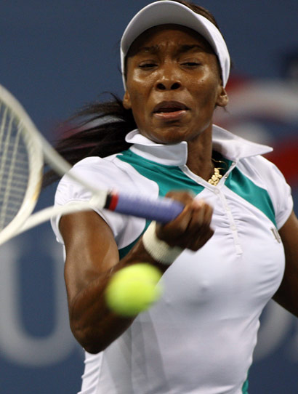
SELF-Care- content
Self-care focuses on 3 main areas:
a) A nutritious diet;
B) Physical activity and exercise and
C) Emotional health.

Slide 15
Tracking
we have adapted the concepts of self-care to develop a tracking form that motivates the individual to integrate self care habits into their daily life.
We have tried this out among frontline workers at KNH and received very positive feedback
Be accountable through – tracking /charting

Slide 16
 | TIP |  |  | Mon | Tue | Wed | Thu | Fri | Sat | Sun
1. | Sleep Routine
 | Wake-up Time
 | Sleep Time
2. | Stay connected-
 | Call friend
 | Call family
3. | Hobby
 | 1
 | 2
4 | Worry window
 | Time:
5. | Wellbeing Practices
 | 1- Meditation/Prayer/Mindfulness
 | 2- Exercise
 | 3- A gratitude journal Give- without expecting back
6. | Eat at least one portion of
 | 1-Fresh fruits
 | 2-Fresh veggies
7. | 1-Drink plenty of freshwater
 | 2-Avoid- Sodas and sugared juices, alcohol
 | DAILY SCORES

Slide 17
Accountability
Responsible Behaviour- doing what you said you would do when you said you would do it.
Sharing- loudly/ verbalising to others is a powerful tool.
Accountability partner- a person helping the other person keep a commitment
Accountability groups are small groups of persons who meet online or offline and who have goals in common.
The group members hold each other accountable for meeting their personal goals.
Form a selfcare accountability group
NOTE- IT IS NOT ABOUT WINNING IT IS BEING PART OF THE RACE

Slide 18
Summary and Conclusion
COVID-19 has changed the way we live, work and socialise
COVID 19 generates a lot of anxiety and stress
Health care providers are experiencing burnout
It is time to rethink new ways to fight back
Stay safe and stay Healthy
Integrate Self-care habits into your and your family’s life style

Slide 19
The University of Nairobi
Vision: A world-class university committed to scholarly excellence

